Slide 1
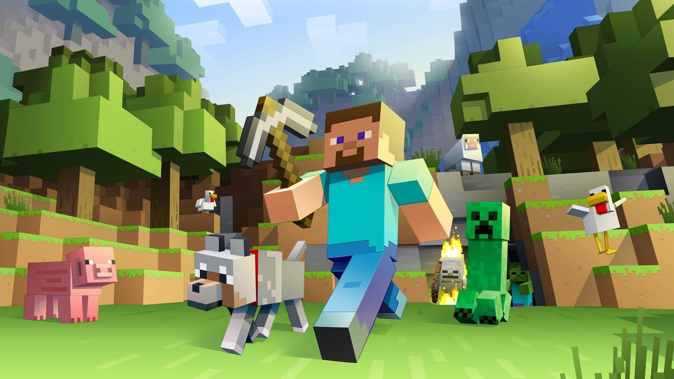
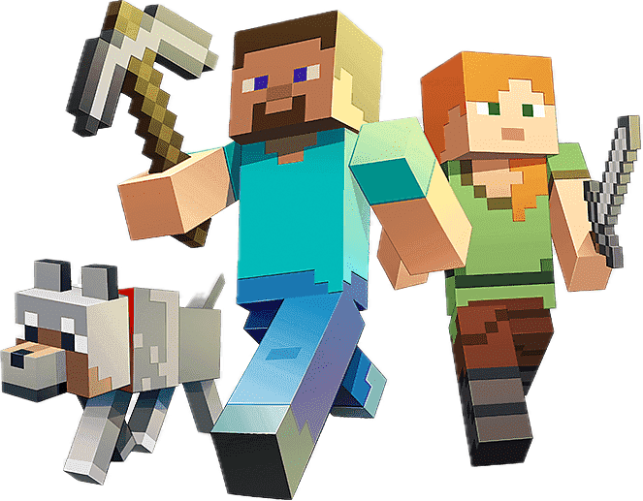
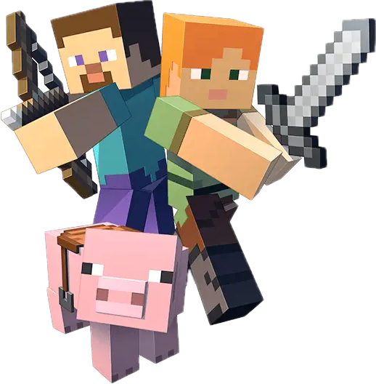
Mining and Crafting Interest: How Minecraft Motivates Girls to Engineering
Start
Options
Quit

Slide 2
Mining and Crafting Interest: How Minecraft Motivates Girls to Engineering
Loading……
Notes:
More specifically Mining and Crafting Interest: "How Minecraft Motivates Girls to Engineering"

Slide 3
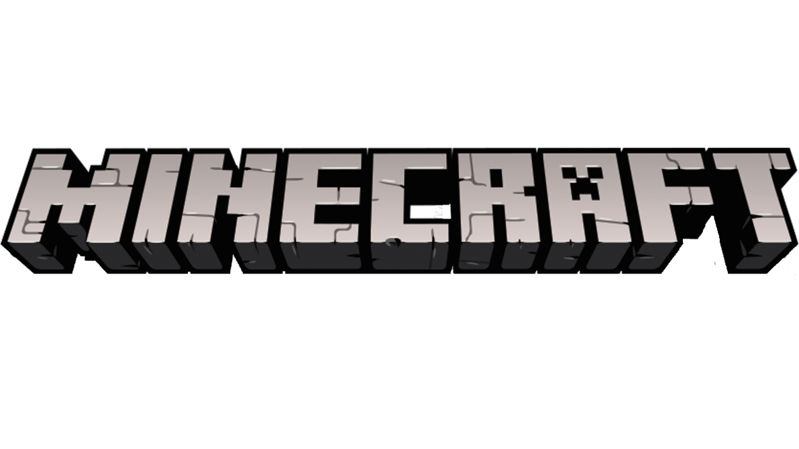
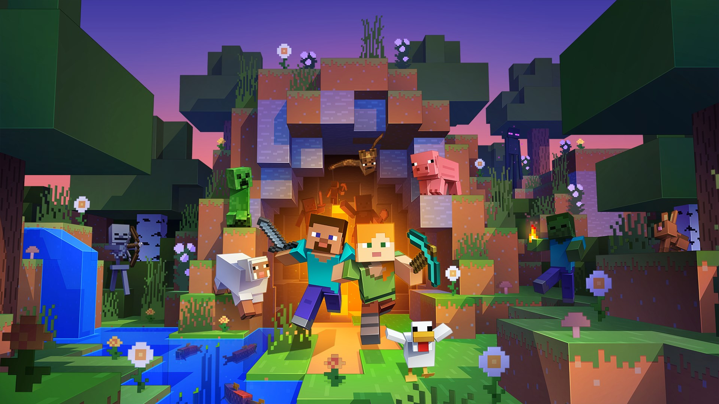
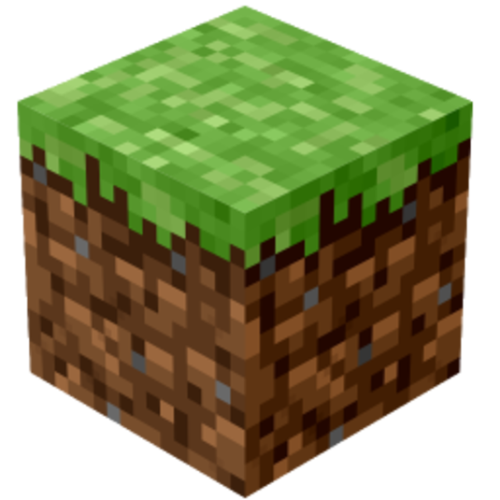
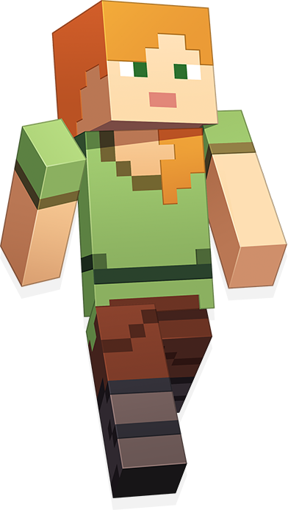
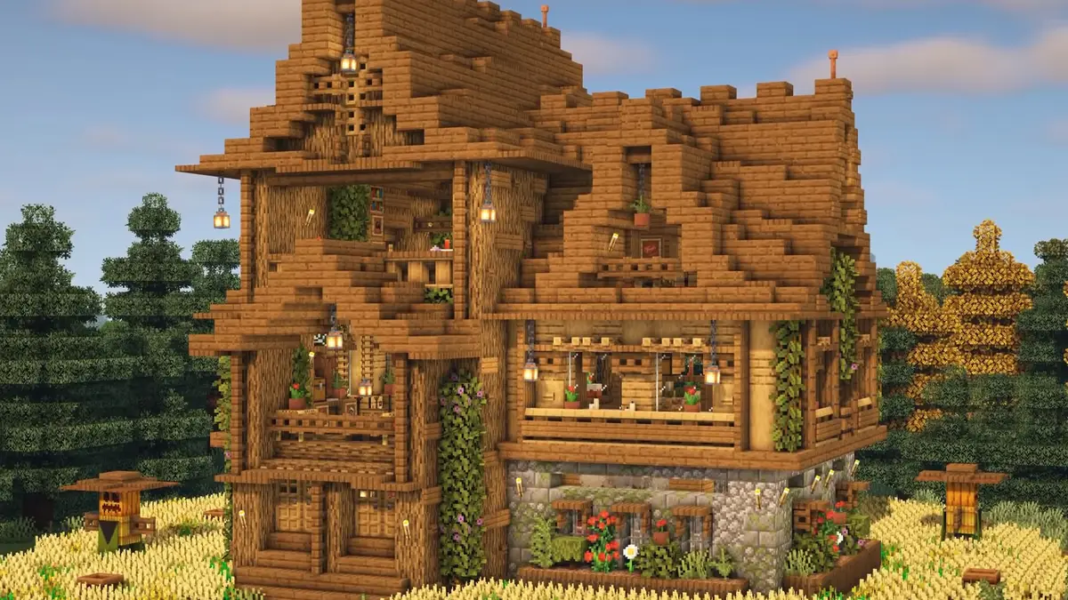
In 2009, Markus "Notch" Persson made a unique game where players could place independent blocks to build exciting things (Nebel et al. 356).
Notes:
So what is Minecraft? In 2009, video game programmer Markus Persson made a unique game where players, represented as a group of pixels, could place independent blocks to build exciting things such as a house (Nebel et al. 356).

Slide 4
Research Question
How can Minecraft, with its interactive problem-solving elements, be used in high school settings to foster an interest in girls in pursuing engineering as a career?
Notes:
The main aim of my literature review was to answer the following research question: How can Minecraft, with its interactive problem-solving elements, be used in high school settings to foster an interest in girls in pursuing engineering as a career?

Slide 5
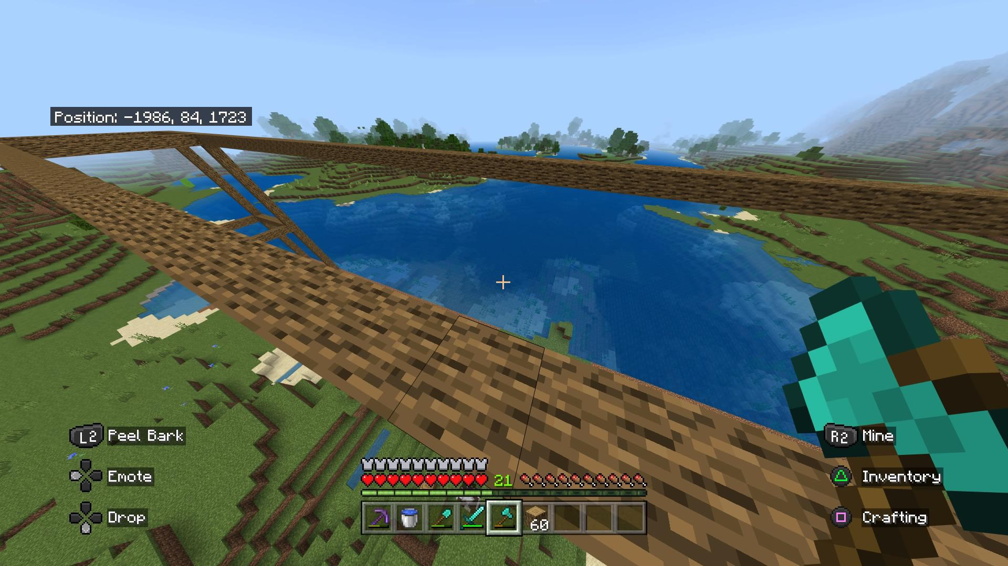
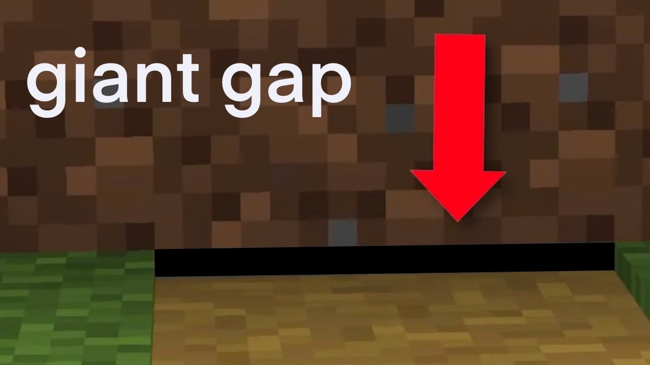
Research Gap
A lot of research has been done on the educational benefits of games (De Aguilera and Mendiz 8).
However, there is a gap in how they affect girls in particular.
Notes:
Despite the growing research by scholars such as De Aguilera and Mendiz on the educational benefits of games, there is a gap in research on how these games particularly affect girls' interest in engineering. Yep hats a pretty big gap

Slide 6
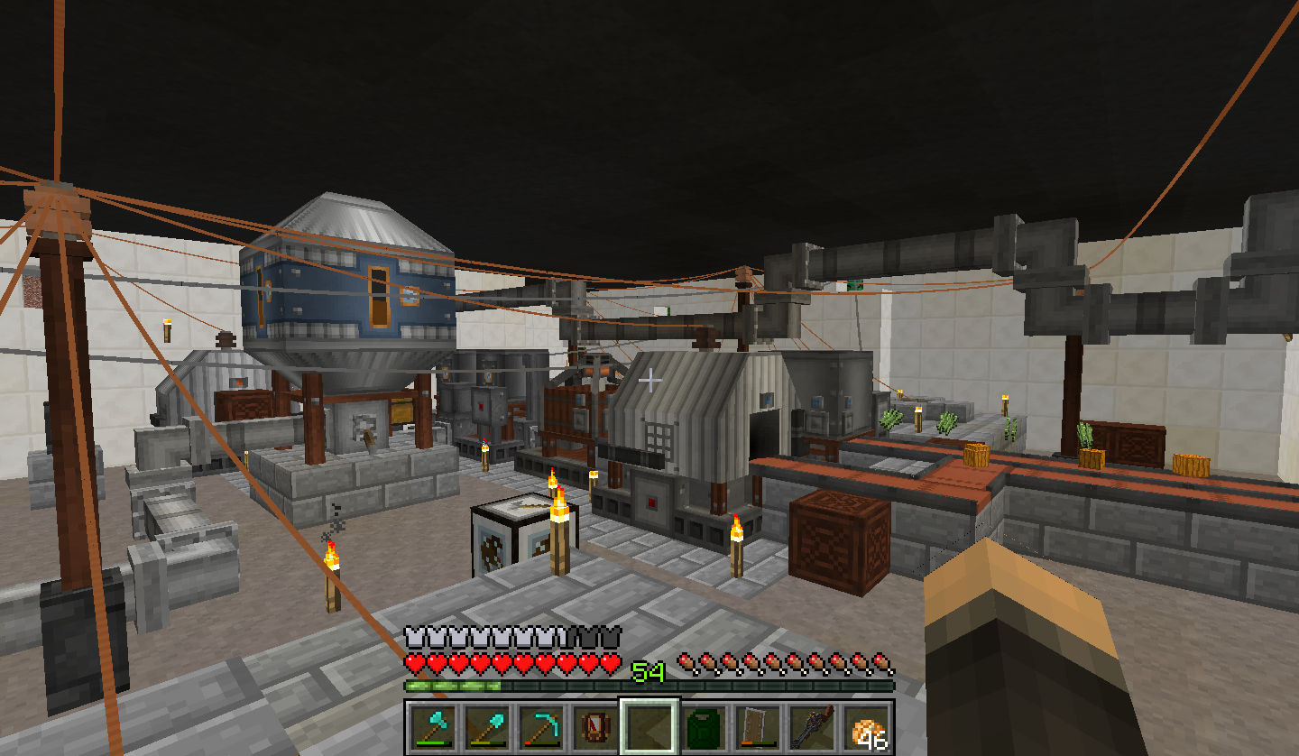
Thesis
Minecraft’s simple interactive gameplay mechanics encourage collaboration, creativity, and problem-solving skills.
It also introduces students to the field of engineering.
My literature review argues that Minecraft’s unique design can foster an interest in engineering among high school girls while examining some negative effects.
Notes:
Lets take a look at my thesis. Minecraft’s simple interactive gameplay mechanics encourage collaboration and enhance creativity and problem-solving skills. Minecraft helps introduce students to the field of engineering through its virtual world and teaches them about the iterative nature of the engineering process.

Slide 7
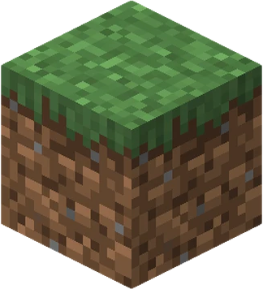
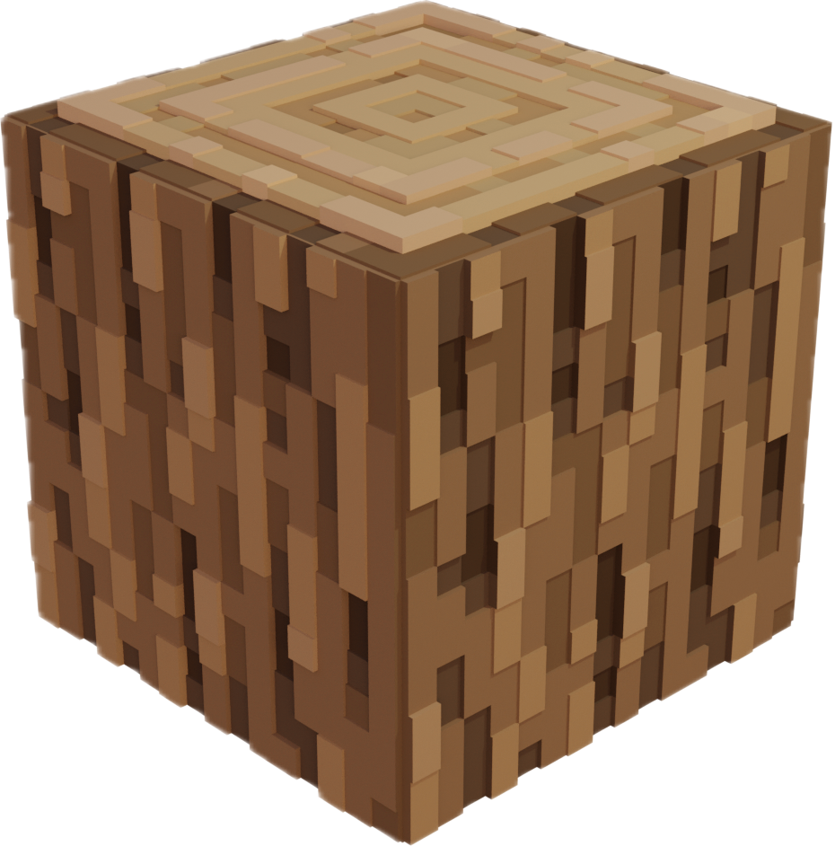
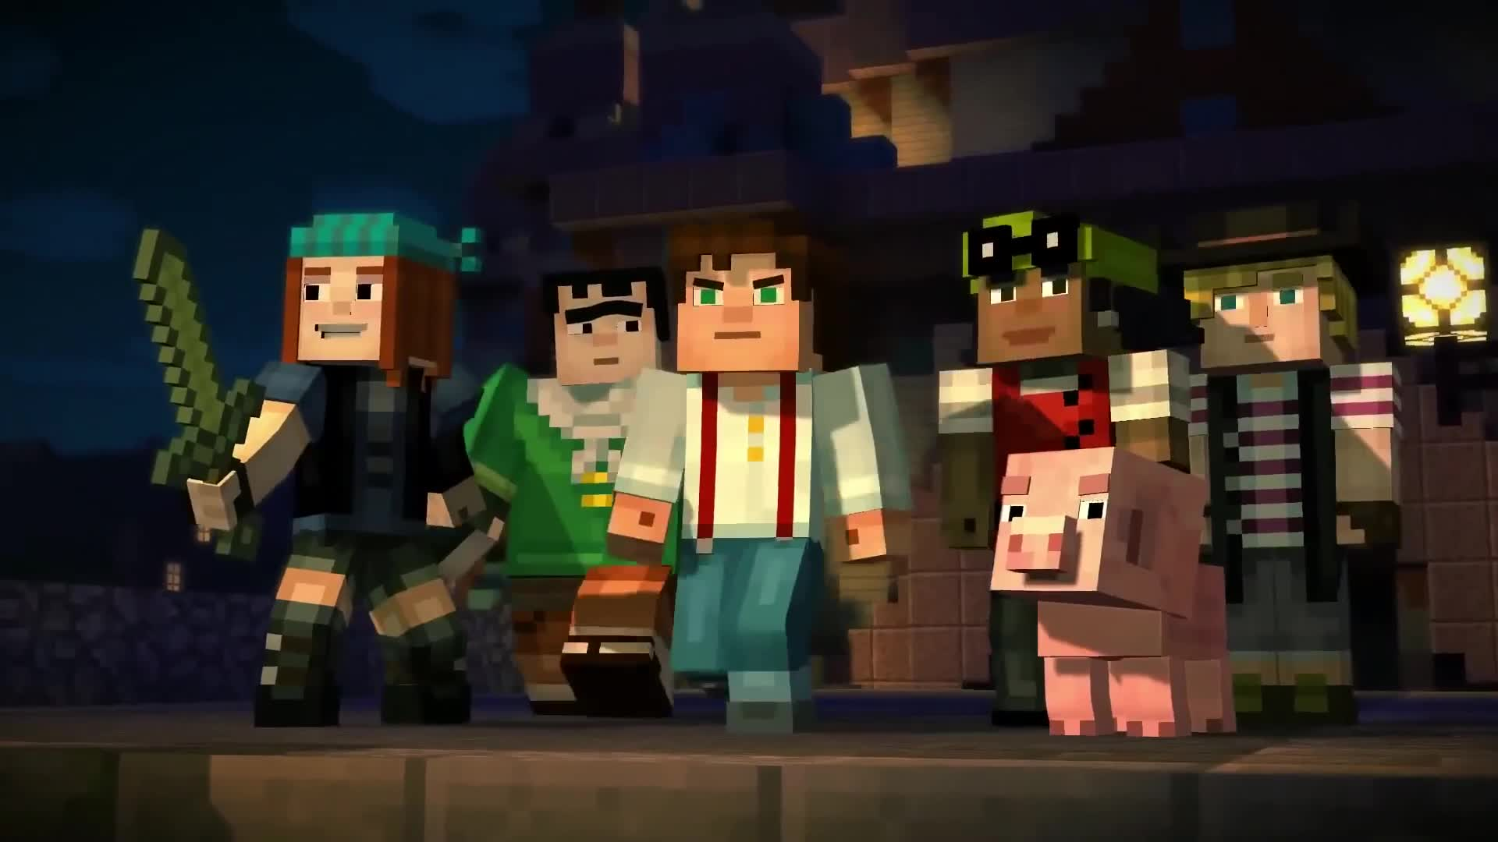
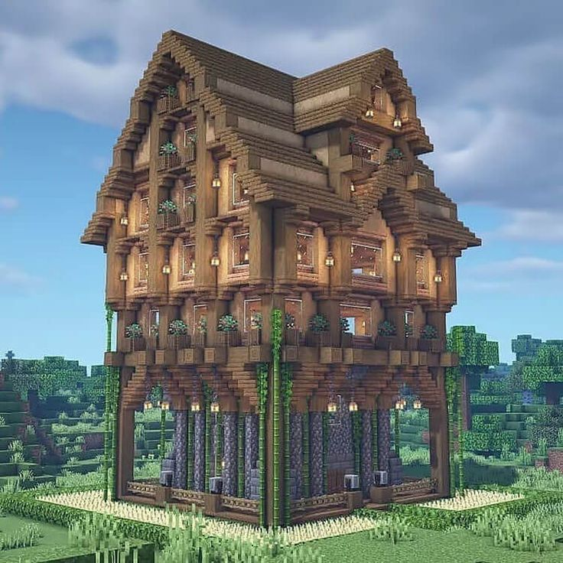
Interactive
Simple game mechanics of Minecraft (Nebel et al. 359).
Students can gain hands-on experience in building.
A study with mostly schoolgirls found that they enjoyed playing Minecraft: Education Edition (Minecraft: EE) because of its interactive and collaborative nature (Pusey and Pusey 30).
Notes:
The simple game mechanics of Minecraft make it an excellent tool for teaching engineering (Nebel et al. 359). Using Minecraft, users can gain hands-on experience in building, crafting, and combining materials such as wood or grass to make new things, from a small light torch to a huge house, thus immersing themselves in an engineering environment. A study comprising mostly girls found that they enjoyed playing Minecraft: Education Edition because of its interactive and collaborative nature, which was very different from their regular schoolwork (30).

Slide 8
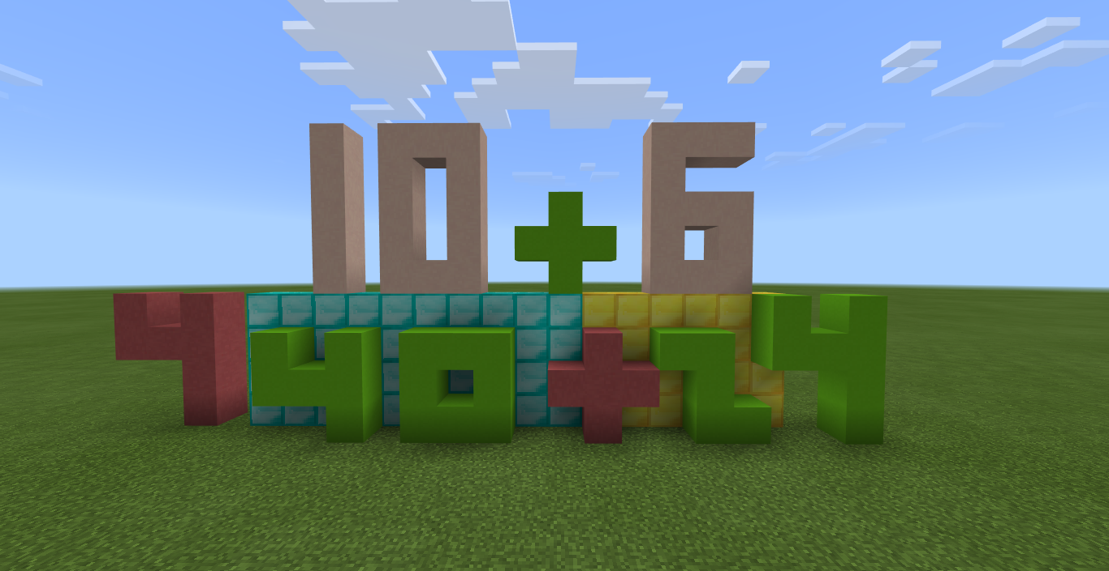
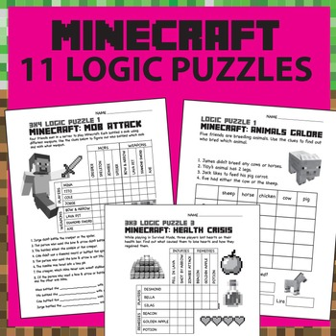
Problem Solving
Playing Minecraft develops critical thinking and logical reasoning (Nguyen et al. 7).
These skills are important in Engineering.
A study found that girls preferred explorative, problem-solving, and creative games like Minecraft to boys (Kinzie and Joseph 655).
Notes:
Lets talk about the problem solving element of Minecraft. Platying Minecraft requires skills such as critical thinking and logical reasoning (Nguyen et al. 7), which are very important in the field of engineering. In a survey, it was found that girls preferred explorative, problem solving and creative games like Minecraft compared to boys (655). Thus, Minecraft can be a great educational game for high school girls to develop their interest in engineering.

Slide 9
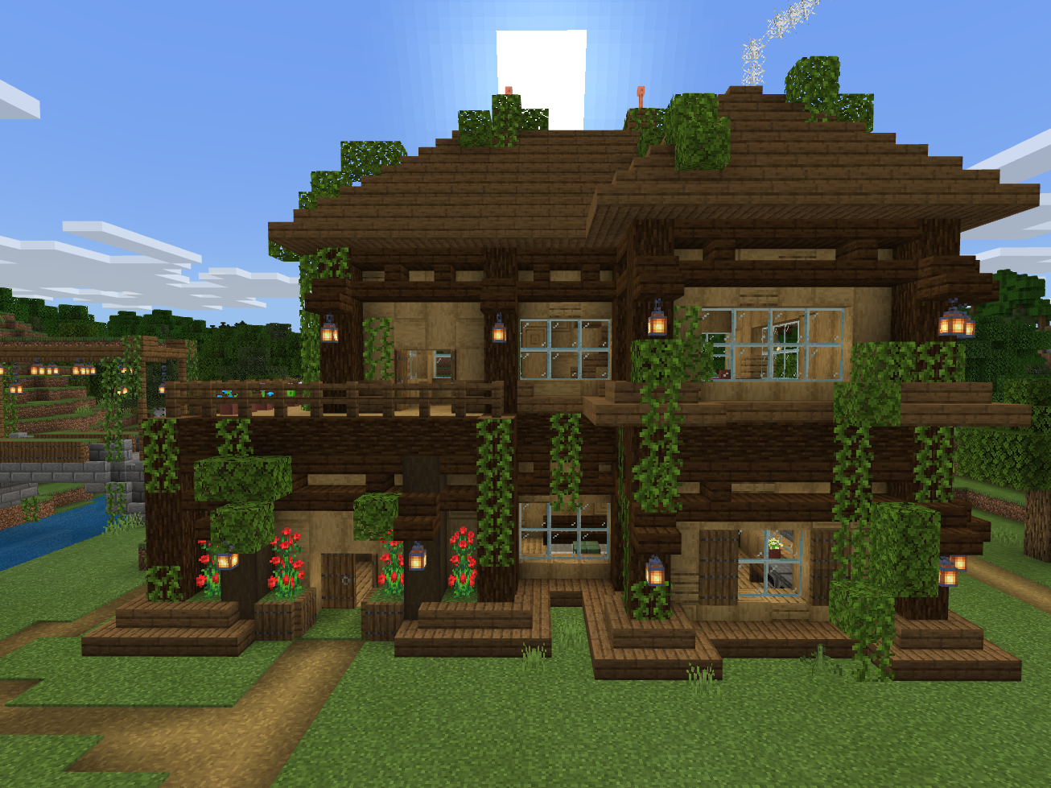
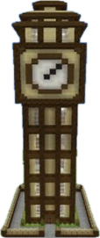
Creativity and Design
The creativity aspect of Minecraft makes use of skills required in engineering.
In an online survey with girls and boys, 100% of the students were thrilled to show their creativity in Minecraft: EE (Nguyen et al. 6).
Notes:
The creativity aspect of Minecraft makes use of skills which are essential in different fields of engineering. For instance, making a clock in Minecraft requires an understanding of electrical circuits which relates to electrical engineering, mathematics, and mechanical engineering (Lane et al. 2). In an online survey, 100% of the students were thrilled to show their creativity in Minecraft: EE mainly because they were allowed to fail in the virtual world, and when they failed, they were able to try again, thus learning from the past (Nguyen et al. 6).

Slide 10
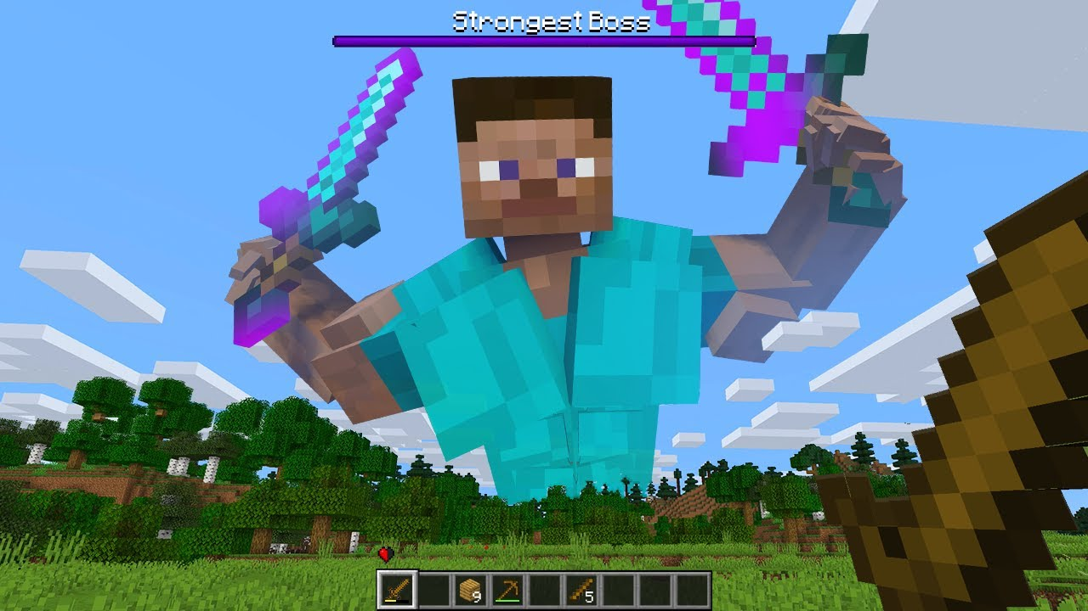
Why Underrepresentation of Women?
Social and cultural reasons.
Encouragement for participating in STEM-related extracurricular activities was lower for girls than boys (Merayo and Ayuso 1482).
Notes:
Let us now take a step back and discuss the reasons for the underrepresentation of Women in Engineering. One massive reason is due to various social and cultural reasons. A study found that in a group of 1562 students, encouragement from families and teachers for participating in STEM-related extracurricular activities was lower for girls than boys (1482).

Slide 11
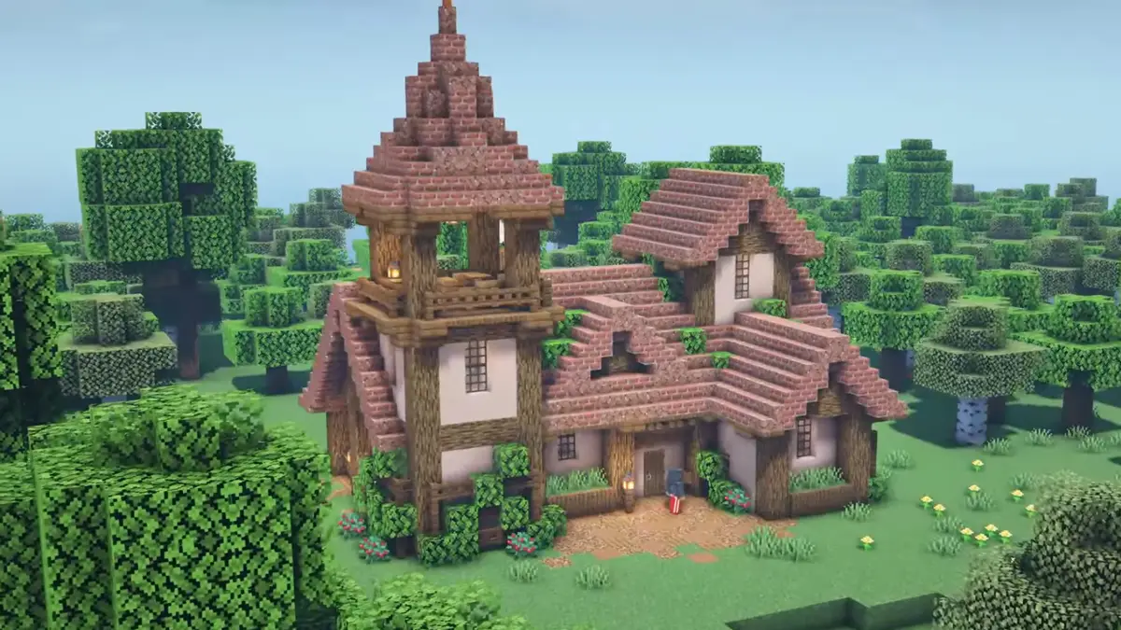
Can Minecraft remove the Gender Gap?
Minecraft was used as a tool to teach about various subjects in STEM (Nebel et al. 357).
A study comprising mostly science girls found that using Minecraft: EE, increased interest levels from 47% to 62% (Pusey and Pusey 29).
Notes:
So, How can Minecraft remove the gender gap? In the past, Minecraft has been used to learn about various subjects, including spatial geometry, physics, chemistry, computer art applications and even high-level courses such as artificial intelligence (Nebel et al. 357). A study primarily comprising girls who study science found that they became more interested in science after using Minecraft: EE in the classroom, with the interest level rising from 47% to 62% (29).

Slide 12
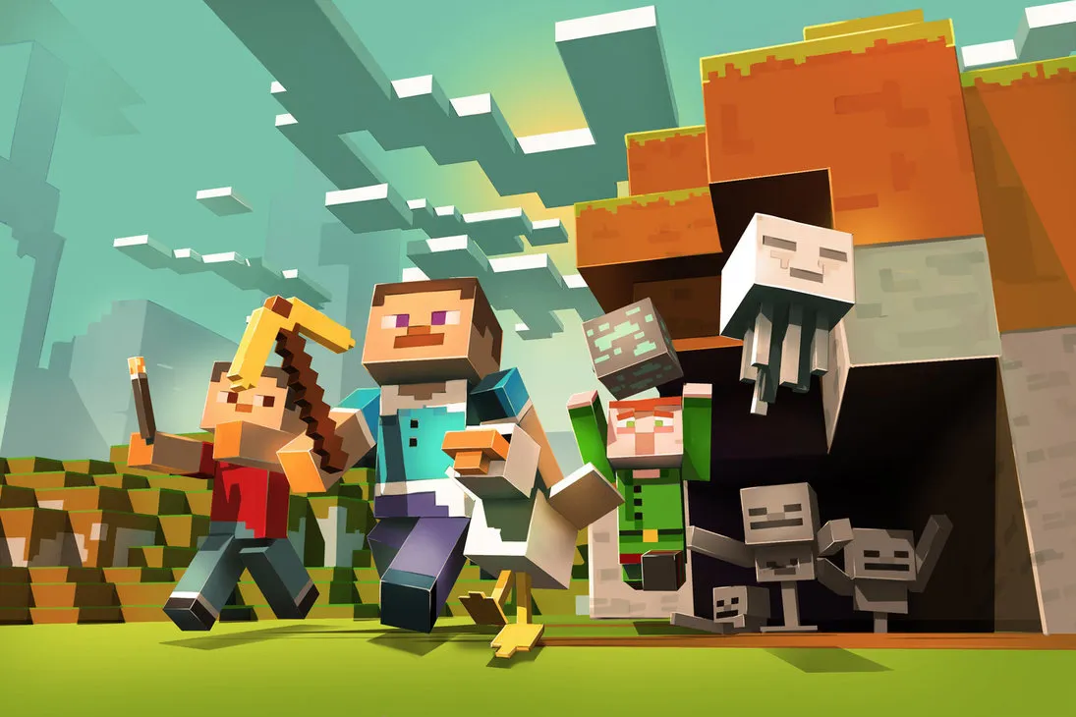
Collaborating in Minecraft
A project found that collaboration with professionals increased girls’ interest (78%) and confidence (77%) in STEM (Mugo et al. 7).
Notes:
Minecraft also gives players the opportunity to collaborate. The National Girls Collaborative Project found that increased collaboration with professionals such as scientists resulted in “girls’ increased interest (78%) and confidence (77%) in STEM” (Mugo et al. 7).

Slide 13
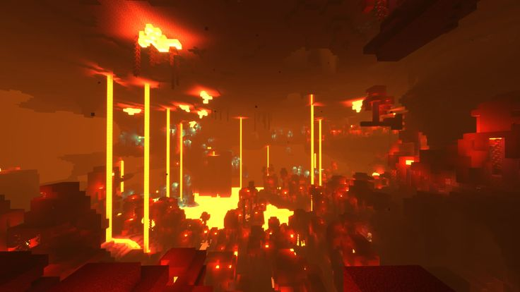
The Bad Side of Minecraft
“My 8 year old loves minecraft [2011, Mojang]. . . . Occasionally we let her play in multi-player if one of us is nearby. One day she was [playing] around and she said, “someone said they want to have sex with me.” I looked at the computer and sure enough, someone had written, “(her name), I want to have sex with you.” I got on the keyboard and wrote, “She’s 8. Say that again.” They then disconnected.” (deWinter and Kocurek 69)
Notes:
While there are many upsides to using Minecraft to motivate girls in high school to pursue engineering, it also has its own limitations. In an email interview by deWinter and Kocurek, the interviewee said:
My 8 year old loves minecraft [2011, Mojang]. . . . Occasionally we let her play in multi-player if one of us is nearby. One day she was [playing] around and she said, “someone said they want to have sex with me.” I looked at the computer and sure enough, someone had written, “(her name), I want to have sex with you.” I got on the keyboard and wrote, “She’s 8. Say that again.” They then disconnected. (69)
These toxic experiences can also negatively affect high school girls and potentially demotivate them from pursuing engineering as a field.

Slide 14
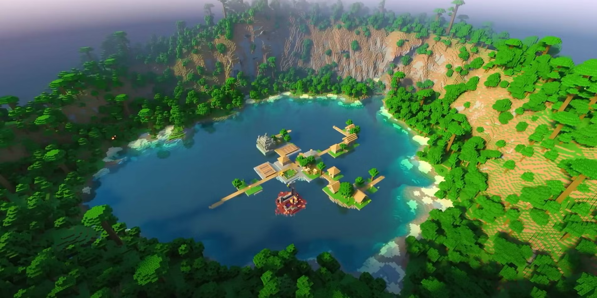
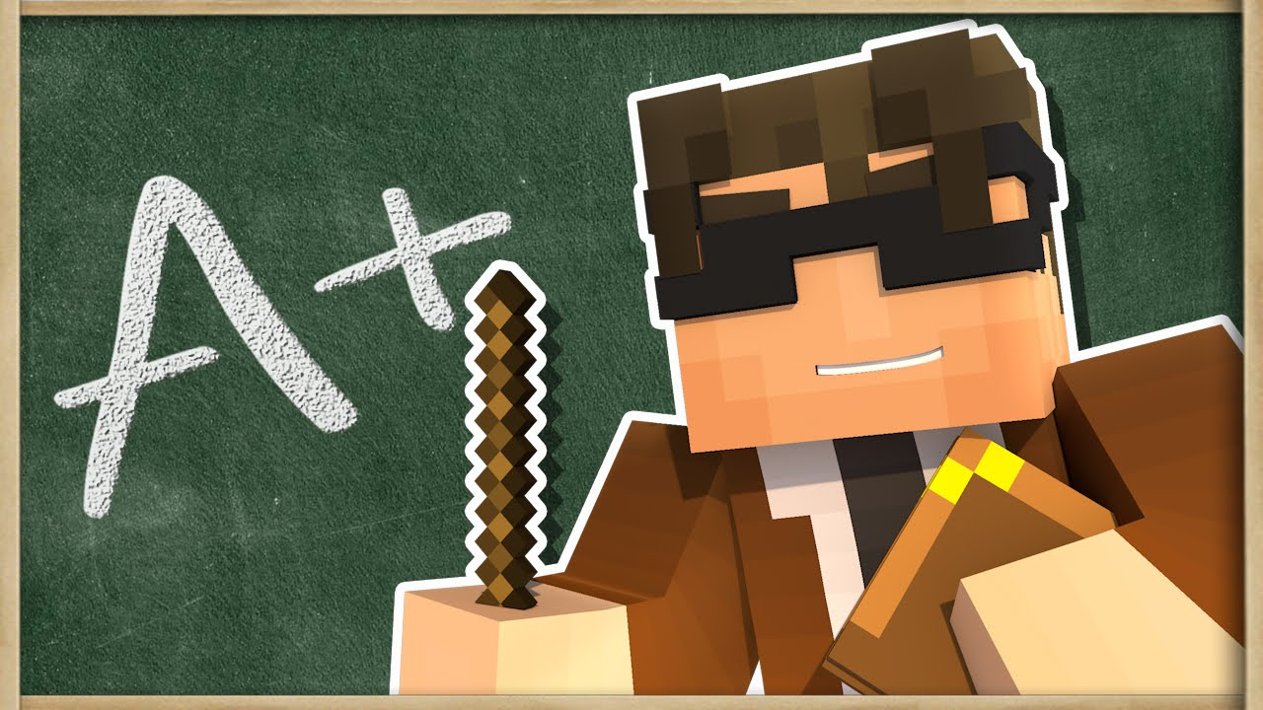
How to Prevent this?
Setting up teachers as moderators.
These moderators will have control over the player’s game and mics (Slovak et al. 5-6).
Notes:
These toxic interactions can be prevented by setting up teachers as moderators who will safeguard students from these negative experiences (Slovak et al. 5). These moderators will have control over the players by being able to freeze players instantly, mute their mics and make a cooldown space where players who cause problems are taken away the capability to build or destroy blocks (Slovak et al. 5-6).

Slide 15
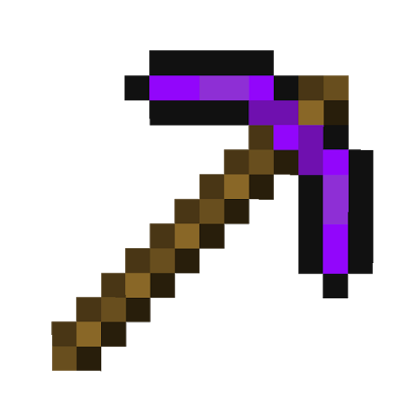
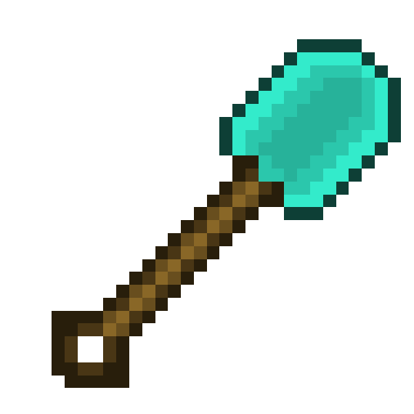
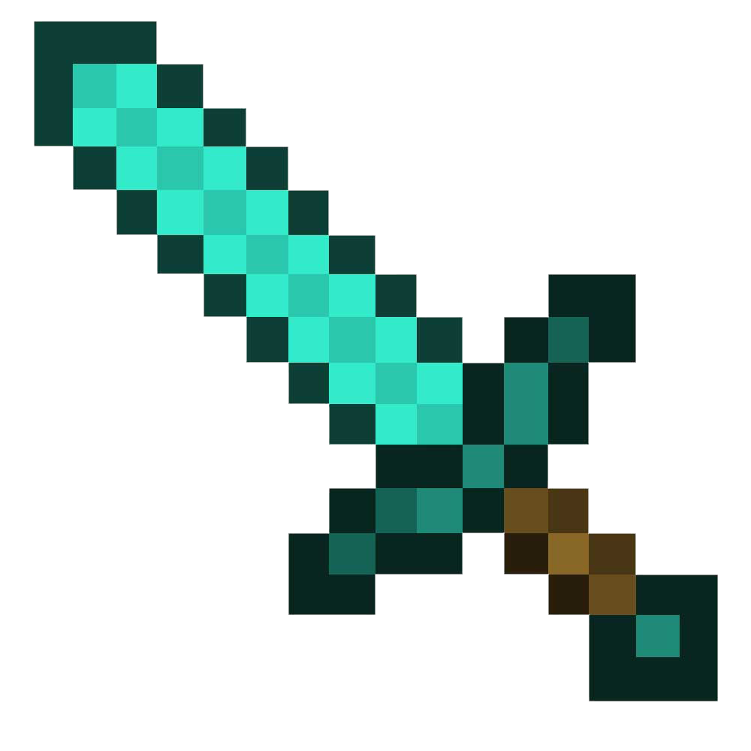
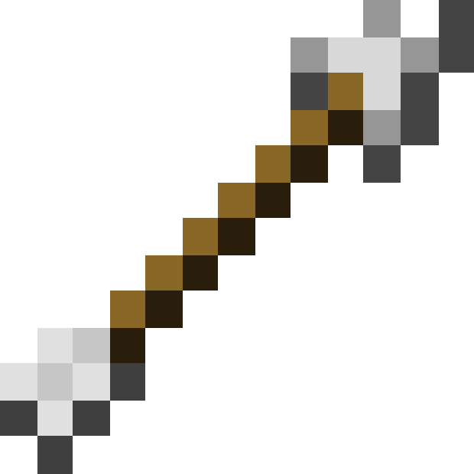
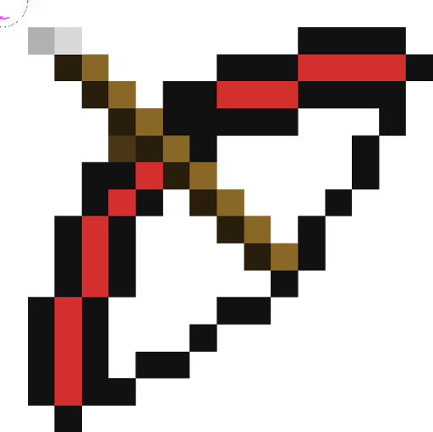
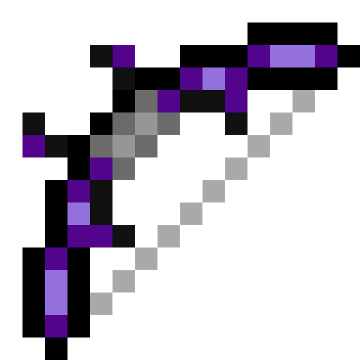
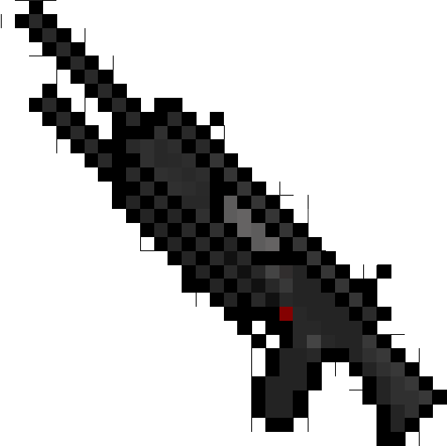
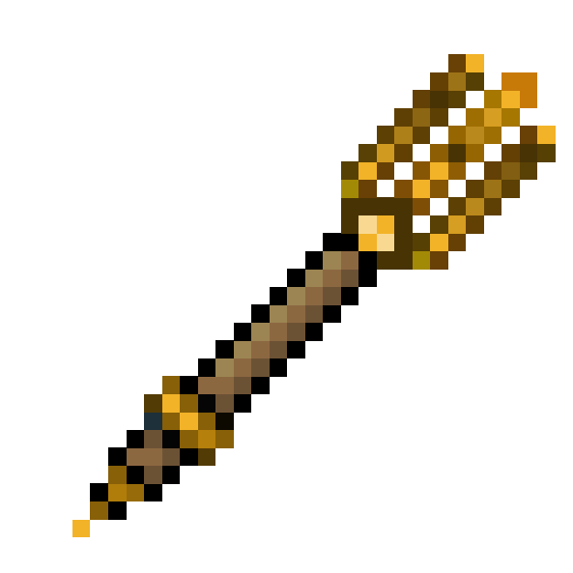
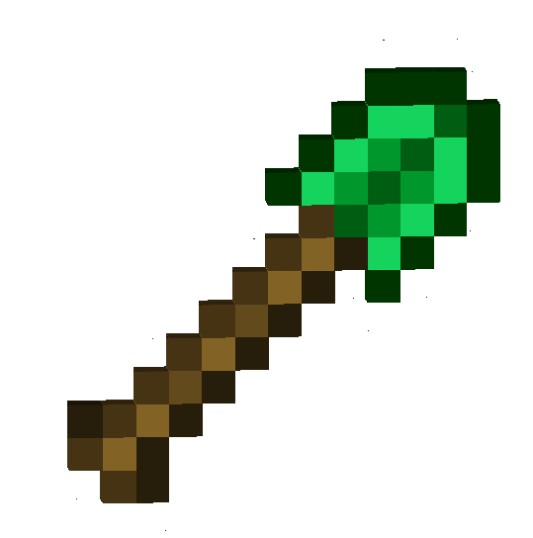
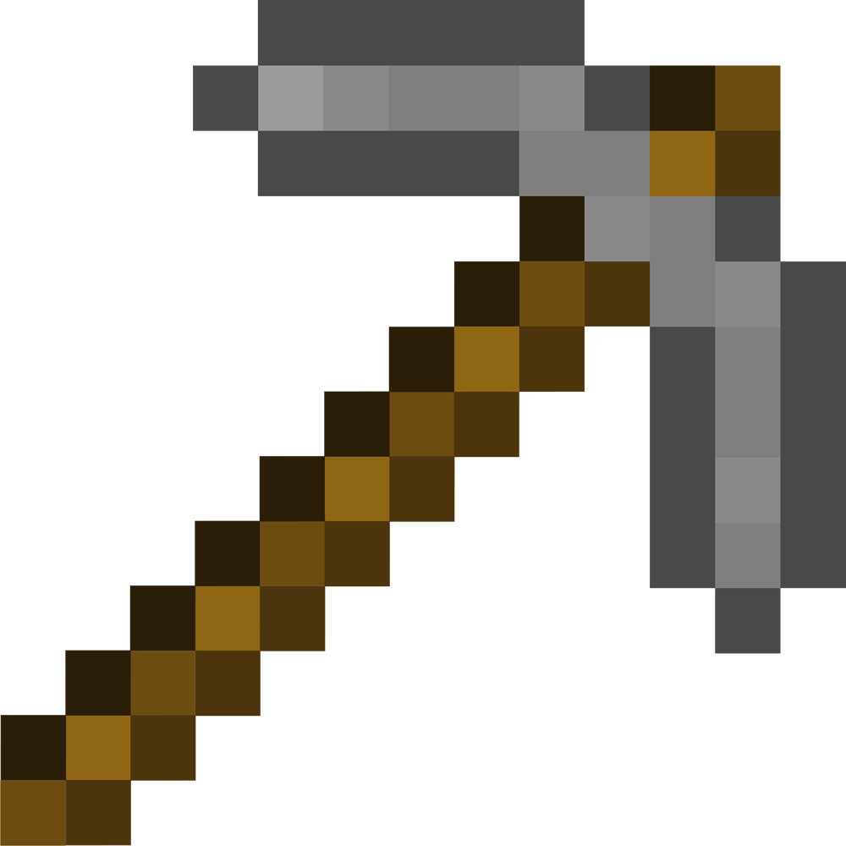
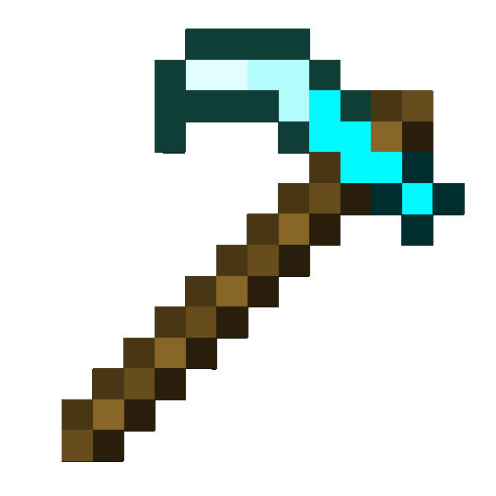
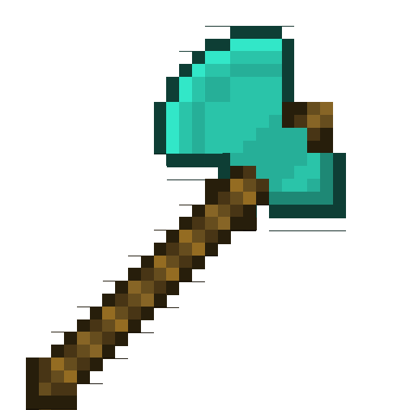
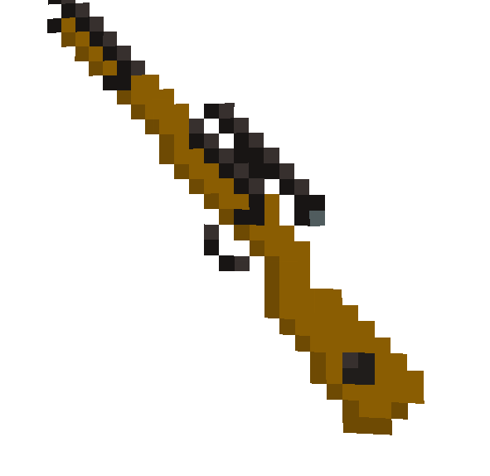
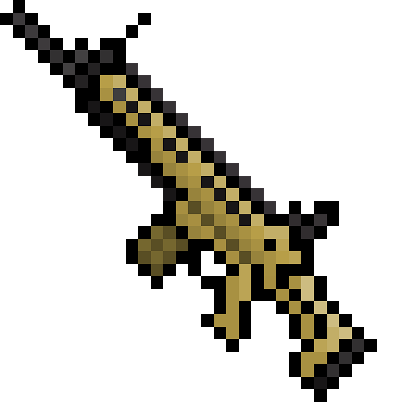
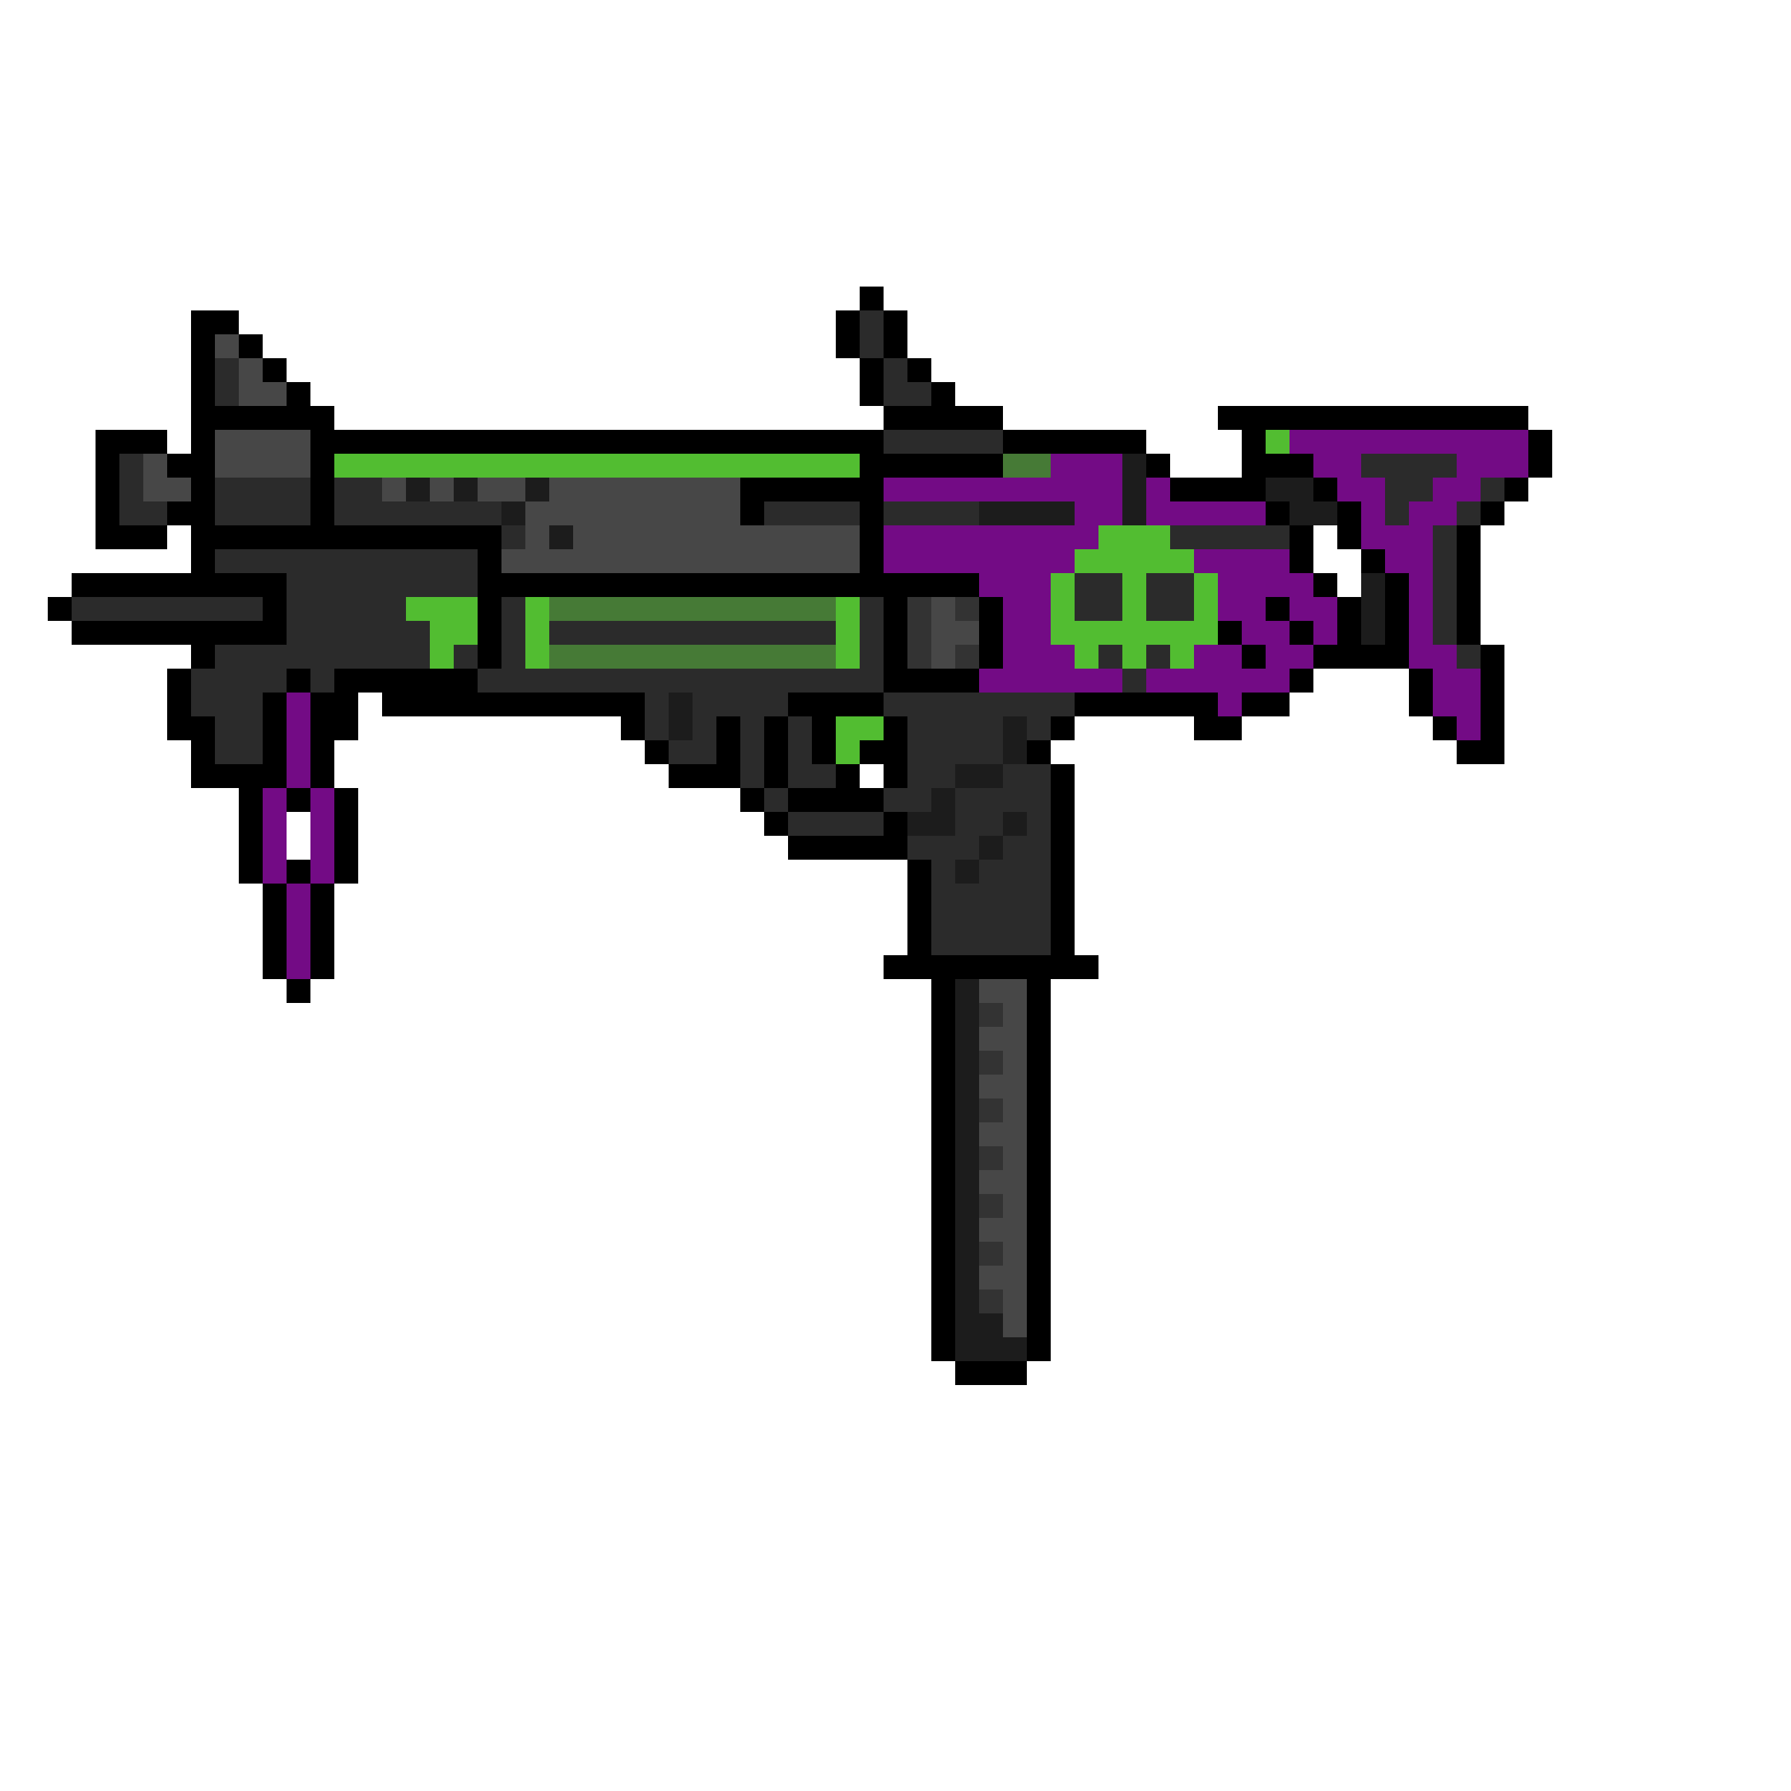
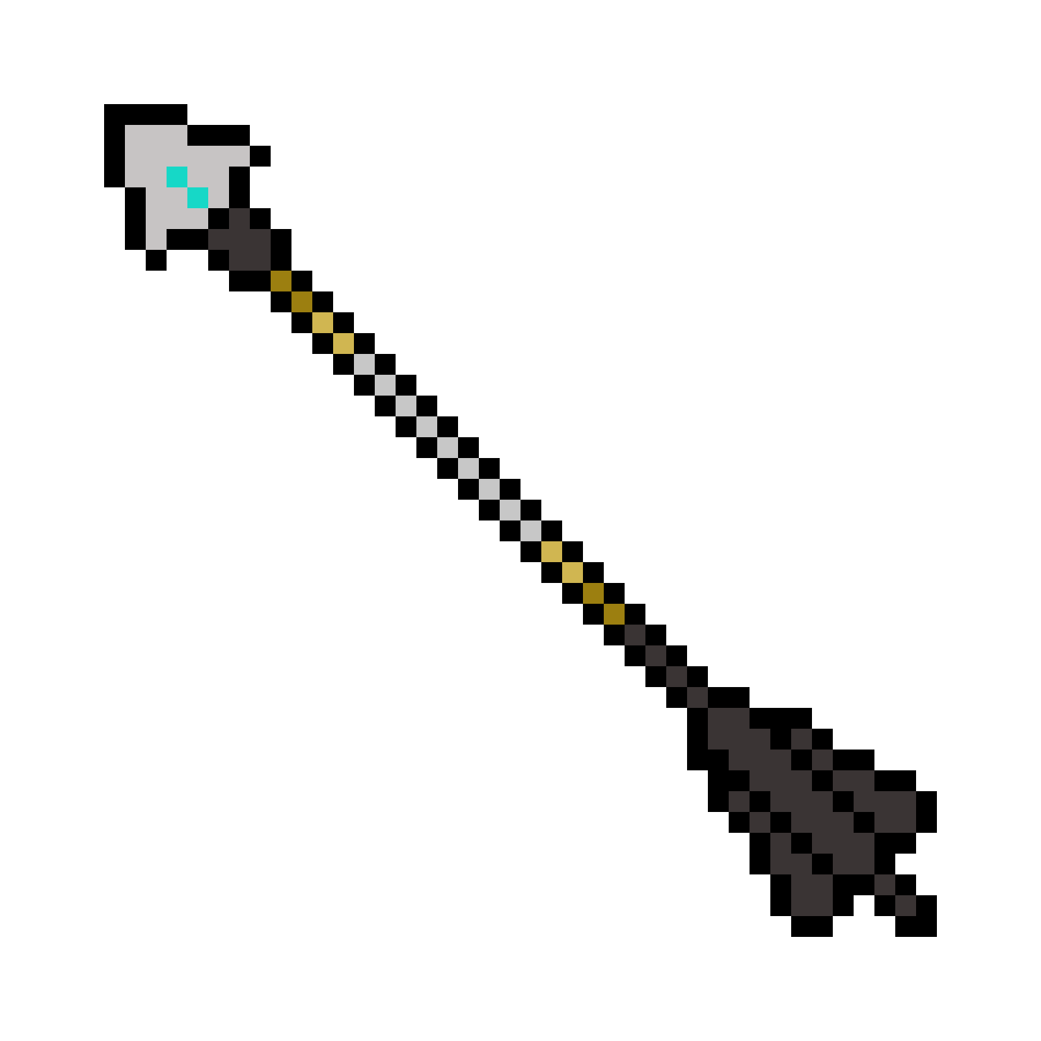
FUTURE STUDY
Future research should focus on efficiently utilizing the positive aspects of Minecraft while implementing strategies to protect students, especially high school girls, from toxic interactions.
Notes:
Future research should focus on efficiently utilizing the positive aspects of Minecraft while implementing strategies to protect students, especially high school girls, from toxic interactions.

Slide 16
Works Cited
Callaghan, Noelene. “Investigating the Role of Minecraft in Educational Learning Environments.” Educational Media International, vol. 53, no. 4, 2016. pp. 244-60. Taylor & Francis, https://doi.org/10.1080/09523987.2016.1254877.
De Aguilera, Miguel, and Alfonso Mendiz. “Video Games and Education: (Education in the Face of a “Parallel School”).” Computers in Entertainment, vol. 1, no. 1, 2003. pp. 1-10. Association for Computing Machinery, https://doi.org/10.1145/950566.950583.
Del Frate, Luca. “Failure of Engineering Artifacts: A Life Cycle Approach.” Science and Engineering Ethics, vol. 19, 2013. pp. 913-44. SpringerLink, https://doi.org/10.1007/s11948-012-9360-0.
deWinter, Jennifer, and Carly A. Kocurek. “‘AW FUCK, I GOT A BITCH ON MY TEAM:’ Women and the Exclusionary Cultures of the Computer Game Complex.” Gaming Representation: Race, Gender, and Sexuality in Video Games, edited by Jennifer Malkowski and TreaAndrea M. Russworm, Indiana University Press, 2017, pp. 57-73. Jstor, https://doi.org/10.2307/j.ctt2005rgq.8.
Esclamado, Maricel A., and Maria Mercedes T. Rodrigo. “Gender Differences in Achievement, Behavior, and STEM Interest Among Learners Using Minecraft.” Research and Practice in Technology Enhanced Learning, vol. 19, 2024. pp. 1-27. RPTEL, https://doi.org/10.58459/rptel.2024.19031.

Slide 17
Works Cited
Kinzie, Mable B., and Dolly R. D. Joseph. “Gender Differences in Game Activity Preferences of Middle School Children: Implications for Educational Game Design.” Educational Technology Research and Development, vol. 56, no. 5/6, 2008. pp. 643-63. Jstor, https://www.jstor.org/stable/25619950.
Lane, H. Chad, et al. “A Taxonomy of Minecraft Activities for STEM.” 25th International Conference on Computers in Education Proceedings, 2017. pp. 1-3. Scopus, https://www.scopus.com/record/display.uri?eid=2-s2.0-85054178277&origin=inward&txGid=cf6aea61a24343a5b0ed283bd9fc39a7.
Legewie, Joscha, and Thomas A. DiPrete. “The High School Environment and the Gender Gap in Science and Engineering.” Sociology of Education, vol. 87, no. 4, 2014. pp. 259-80. SageJournals, https://doi.org/10.1177/0038040714547770.
Merayo, Noemì, and Alba Ayuso. “Analysis of Barriers, Supports and Gender Gap in the Choice of STEM Studies in Secondary Education.” International Journal of Technology and Design Education, vol. 33, 2023. pp. 1471-98. SpringerLink, https://doi.org/10.1007/s10798-022-09776-9.
"Minecraft® Redstone Engineers" YouTube, uploaded by Black Rocket Productions, 18 Feb. 2020, https://youtu.be/2ldLsuE9Q68?si=hvDZhSvyrpLDurYt.

Slide 18
Works Cited
Mugo, Mercy, et al. “Evidence-based Strategies for Attracting and Retaining Girls and Women in STEM.” NSF Includes National Network, 2021. pp. 1-21, https://swe.org/wp-content/uploads/2021/08/Evidence-based-Strategies-for-Attracting-and-Retaining-Gilrs-and-Women-in-STEM.pdf.
Nebel, Steve, et al. “Mining Learning and Crafting Scientific Experiments: A Literature Review on the Use of Minecraft in Education and Research.” Journal of Educational Technology & Society, vol. 19, no. 2, 2016. pp. 355-66. Jstor, https://www.jstor.org/stable/10.2307/jeductechsoci.19.2.355.
Nguyen, Thu-Hien, et al. “Design and Evaluate a Stem-oriented Education Teaching Plan by Exploiting the Strength of Minecraft Education Gamebased Platform.” AIP Conference Proceedings, vol. 2685, no. 1, 5 May 2023. pp. 1-9. AIP Publishing, https://doi.org/10.1063/5.0112025.
Pusey, Megan, and Grant Pusey. “Using Minecraft in the Science Classroom.” International Journal of Innovation in Science and Mathematics Education, vol. 23, no. 3, 2015. pp. 22-34. ResearchGate, https://www.researchgate.net/publication/292353803_Using_minecraft_in_the_science_classroom.
Slovak, Petr, et al. “Mediating Conflicts in Minecraft: Empowering Learning in Online Multiplayer Games.” Proceedings of the 2018 CHI Conference on Human Factors in Computing Systems, no. 595, 2018. pp. 1-13. Association for Computing Machinery, https://doi.org/10.1145/3173574.3174169.

Slide 19
THANK
YOU
Quit
Restart
Muhammad Adil Sameer
Few ideas were
inspired by Slide Chef.

